Slide 1
STRESS AND THE PRAYER INTERCESSOR
Dr. Sandra Reid (MD)
Consultant Psychiatrist

Slide 2
How stress affects the life of a prayer intercessor
What is stress?
How does stress affect us?
Why do we need to deal with stress?
What is God’s recommendation for stress management?

Slide 3
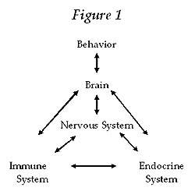
Psychoneuroimmunology

Slide 4
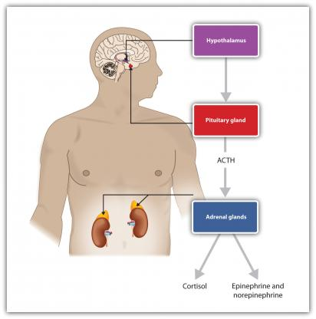
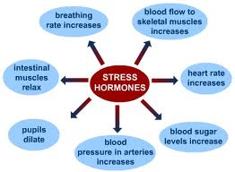

Slide 5
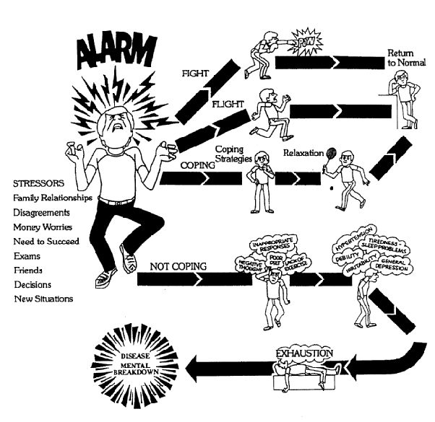

Slide 6
Many health problems are caused or exacerbated by stress, including:
Pain of any kind
Heart disease
Digestive problems
Sleep problems
Depression
Obesity
Asthma
Autoimmune diseases such as thyroid disease, lupus, rheumatoid arthritis
Diabetes
Depression
Anxiety
Irritable bowel syndrome
Gastric ulcers
Crohn’s disease
Yeast infections
Fibromyalgia
Migraines
Skin conditions such as eczema, acne, psoriasis

Slide 7
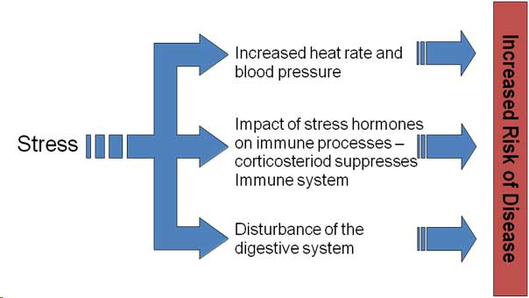
How does stress increase the risk of disease?

Slide 8
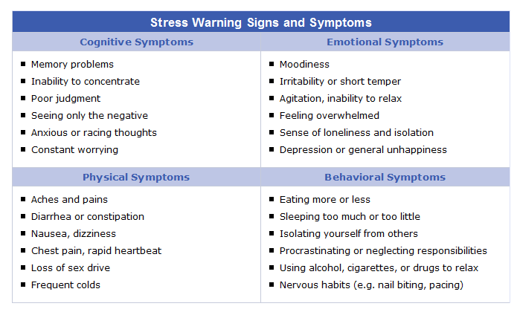

Slide 9
Common approaches to stress management
Reduce stress levels through coping mechanisms including relaxation therapy, deep breathing and meditation
Remove negative self talk, recognize negative patterns of thinking and change them to more positive thoughts
Venting emotions through talking to a trustworthy listener, or keeping a journal
EXERCISE

Slide 10
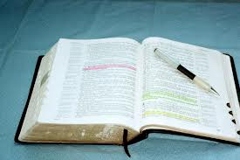
BACK TO THE BIBLE!
Let this mind be in you which also was in Christ Jesus. Phillipians 2:5
But we all, with open face beholding as in a glass the glory of the Lord, are changed into the same image from glory to glory, even as by the Spirit of the Lord. (2 Cor 3:18)

Slide 11
The Psalm 1:2 recipe for stress management
But his delight is in the law of the Lord; and in his law doth he meditate day and night. (Psalm 1:2)
This book of the law shall not depart out of thy mouth; but thou shalt meditate therein day and night, that thou mayest observe to do according to all that is written therein: for then thou shalt make thy way prosperous, and then thou shalt have good success. (Joshua 1:8)

Slide 12
Prayer for stress management
Prayer is an important resource for coping with pain and illness and improving health and general well being.
Prayer was the most popular alternative form of therapy among 31,000 US persons interviewed

Slide 13
People are praying for health
43% of respondents pray for their own health
24% sought the prayer of others
10% participated in groups that focused specifically on personal health issues
35% of respondents in another study used prayer for health concerns
75% prayed for wellness
22% prayed for specific health conditions
70% of those who prayed reported prayer to be very helpful

Slide 14
There is a positive association between prayer and improved health outcomes
Conversational prayer - conversation with God about day-to-day matters, seeking guidance and counsel, or expressing gratitude for life and wellbeing
Meditative prayer - contemplating spiritual themes and the relationship of the divine to mankind
Ritual prayer - reciting or reading well known prayers such as the Lord’s Prayer
Intercessory prayer - as petitions on behalf of others for their health and wellbeing

Slide 15
Proposed theories for how prayer works
Relaxation response
Placebo
It promotes positive emotions
A channel for supernatural intervention

Slide 16
Benefits of transcendental meditation and mindfulness meditation
reduces high blood pressure
reduces atherosclerosis
reduces constriction of blood vessels
reduces thickening of coronary arteries
reduces use of antihypertensive medication
reduces risk of MI and stroke
reduces blood sugar
reduces mortality rates
helps coping with cancer
helps coping with pain
improves immune system
increases CD4 counts in HIV/AIDS
increase control over addictive disorders
helps depression, anxiety, PTSD

Slide 17
For people who are not ill
Meditation has been shown to:
decrease stress
improve coping
reduce anxiety and ruminations
help with burnout
enhance learning

Slide 18
Features of meditation
“Meditation” refers to a group of techniques, most of which originated in Eastern religious or spiritual traditions
Practiced today for stress reduction and other health-related purposes.
Common elements of most types of meditation include:
a space with minimal distractions
a specific comfortable position
a particular focus of attention
an open attitude.

Slide 19
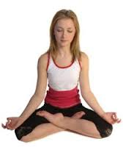
Transcendental meditation
Uses a mantra
Based on the tradition of enlightenment
The mind self-transcends and settles inward to the source of thought
Mindfulness based stress reduction
Derived from Buddhist insight meditation
Develops the skill of paying attention to inner and outer experiences
One is instructed to be present n the moment
Important in the path to enlightenment

Slide 20
Focus and purpose of different types of meditation
 | Focus | Purpose
Transcendental meditation | Inwards to the source of thought | Enlightenment
Mindfulness meditation | Inner and outer experiences and thoughts | Enlightenment
Prayerful meditation | God and His law | Transformation

Slide 21
Is all meditation the same?
Not many studies have been done but there are already reports of differences found between prayer and non-spiritual meditation and relaxation.
Prayerful meditation shows beta brain waves as seen in alert and attentive communication
Other types of meditation show increased alpha and theta waves

Slide 22
Thank You!
Questions and Discussion

